Slide 1
Breast Cancer Prediction
SC1015 DSAI Mini Project
Ang Yvette
Chua Sym Eyan
Tan Hui Ling

Slide 2
Content
Problem Formulation
Dataset and EDA
01
Cleaning and exploring the dataset
02
Establishing a need for breast cancer predictive models
Machine Learning Techniques
Model Comparisons
03
Data-driven insights and concluding thoughts
04
Analysis of predictive models
and their classification accuracies

Slide 3
PROBLEM FORMULATION
01

Slide 4
Background Information
The need for better solutions
01
Most common cancer among women in Singapore
02
2.3 million women diagnosed and 670 000 deaths globally in 2022.
03
With early detection, breast cancer can be effectively treated.
Notes:
https://www.gleneagles.com.sg/conditions-treatments/cancer-care/cancer-types#:~:text=Breast%20cancer%20is%20the%20most%20common%20cancer%20among%20women%20in%20Singapore.
https://www.who.int/news-room/fact-sheets/detail/breast-cancer

Slide 5
Background Information
The need for better solutions
01
Most common cancer among women in Singapore
Large scope of the problem
02
2.3 million women diagnosed and 670 000 deaths globally in 2022.
The need for good diagnostic solutions
03
With early detection, breast cancer can be effectively treated.
Notes:
https://www.gleneagles.com.sg/conditions-treatments/cancer-care/cancer-types#:~:text=Breast%20cancer%20is%20the%20most%20common%20cancer%20among%20women%20in%20Singapore.

Slide 6
Background Information
The gap in current diagnostic solutions
01
12.5%
screening mammograms fail to detect breast cancer
02
40 million
radiologist errors per annum
03
75%
surveyed doctors showed signs of exhaustion

Slide 7
Problem Statement
How can machine learning models, trained on patient data, enhance the early diagnosis of breast cancer by accurately classifying the disease?
Ultimately, a medical professional should confirm the results, but machine learning can augment the initial prediction phase.

Slide 8
Data set and Exploratory Data Analysis
02

Slide 9
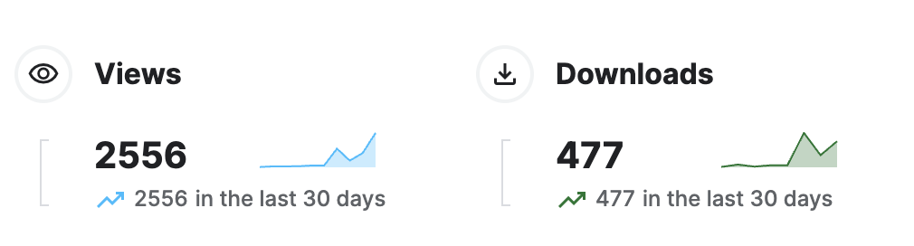
Data set
UCI ML Breast Cancer Wisconsin (Diagnostic) datasets
Obtained from Kaggle
Last updated on 11 April 2024, and is constantly being used by a large number of people online
Types of data in the dataset
Mean
Worst
Error
Data columns representing error was removed.
For our project, we decided that only mean and worst data are relevant

Slide 10
Cleaning the data set
Redundant columns
Outlier Removal
Skew Analysis
Error columns were dropped as mentioned previously
Kurtosis is a measure of whether the data are heavy-tailed or light-tailed relative to a normal distribution.
Skewness is a measure of symmetry of the data set.
Ideally, kurtosis should be as close to 0 as possible.
Ideally, skewness should be as close to 0 as possible.
To address the high kurtosis, we removed outliers through IRQ.
To address skewness of the data, we normalized the data using a log scale
Outliers are typically defined as data points that fall below Q1 - 1.5 * IQR or above Q3 + 1.5 * IQR.

Slide 11
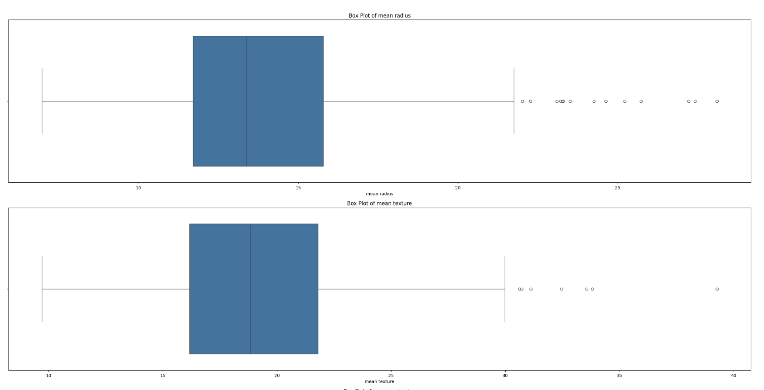
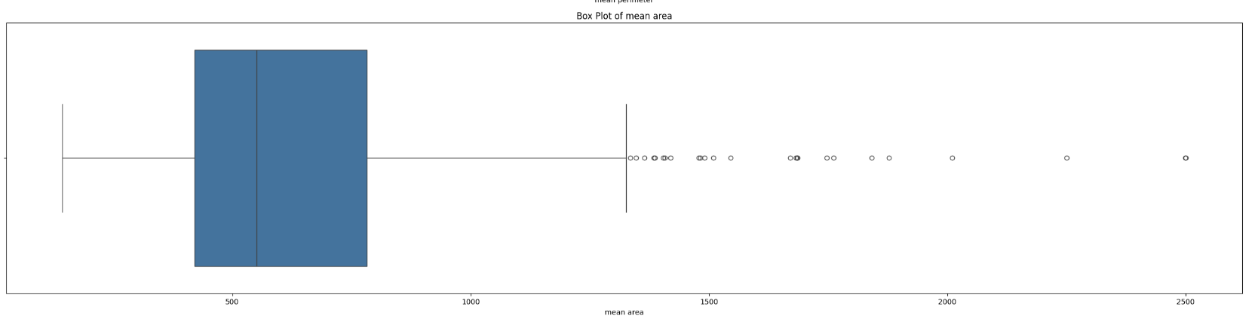
Outlier Removal
Box Plots before cleaning
The box plots were plotted for every column in our jupyter notebook.
Here are a few examples of the box plots from the mean radius, mean texture, and mean area columns that show that were outliers present in the raw data.

Slide 12
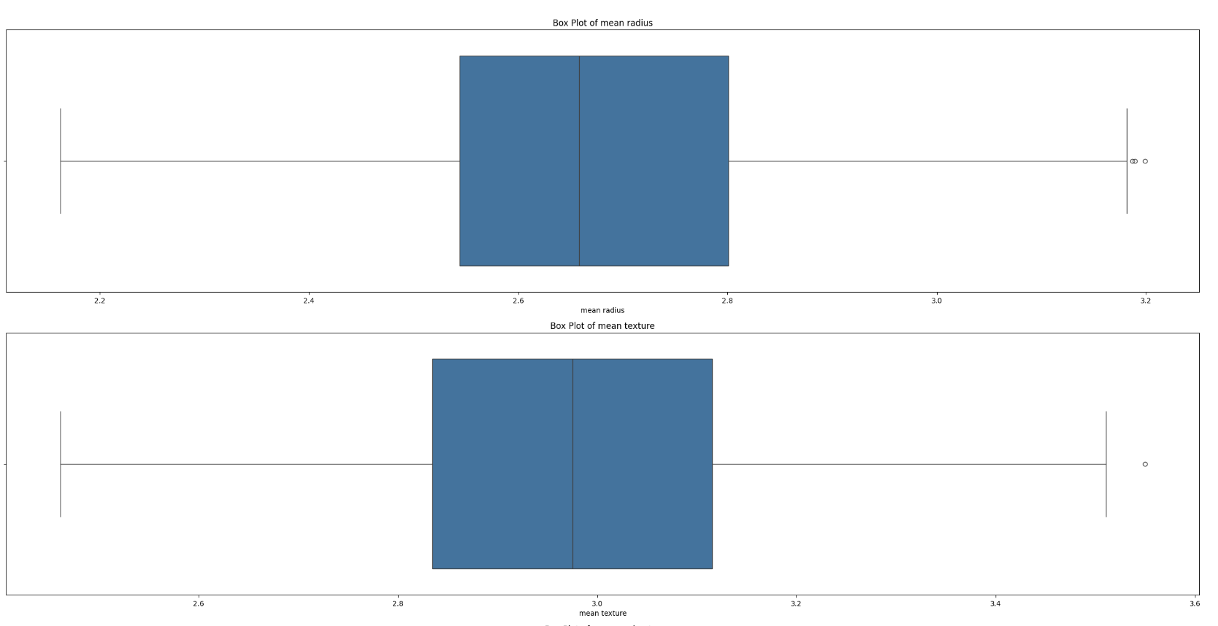
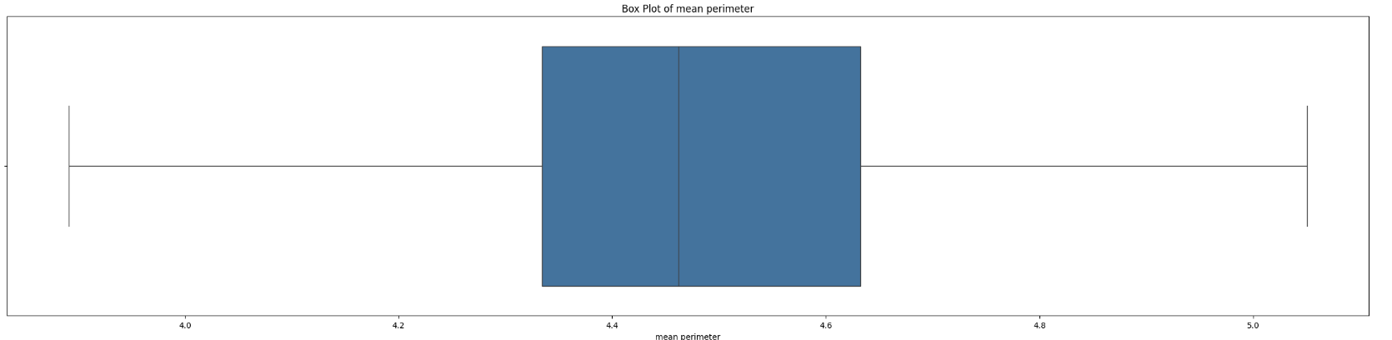
Outlier Removal
Box Plots after cleaning
Here are the box plots for the mean radius, mean texture, and mean area columns from the cleaned data
This verifies that the number of outliers have been significantly decreased after we have cleaned the data set.
This is similar for all of the other columns in our data set.

Slide 13
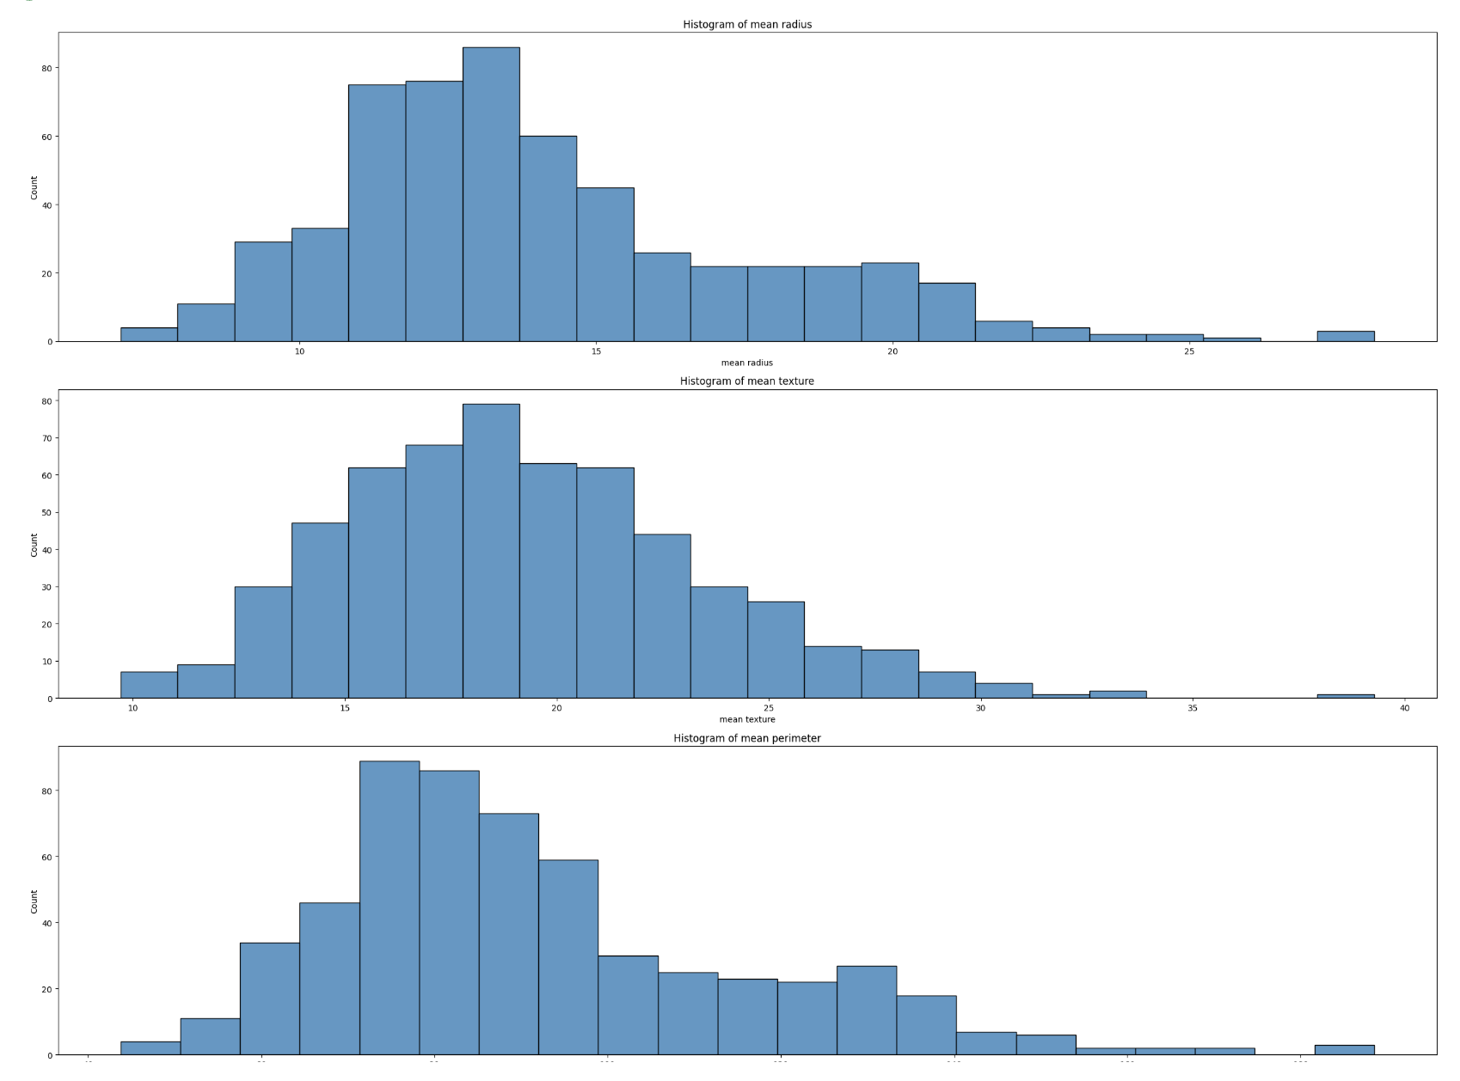
Skew Analysis
Histograms before cleaning
The histograms were plotted for every column in our jupyter notebook.
Here are a few examples of the histograms from the mean radius, mean texture, and mean area columns from the raw data

Slide 14
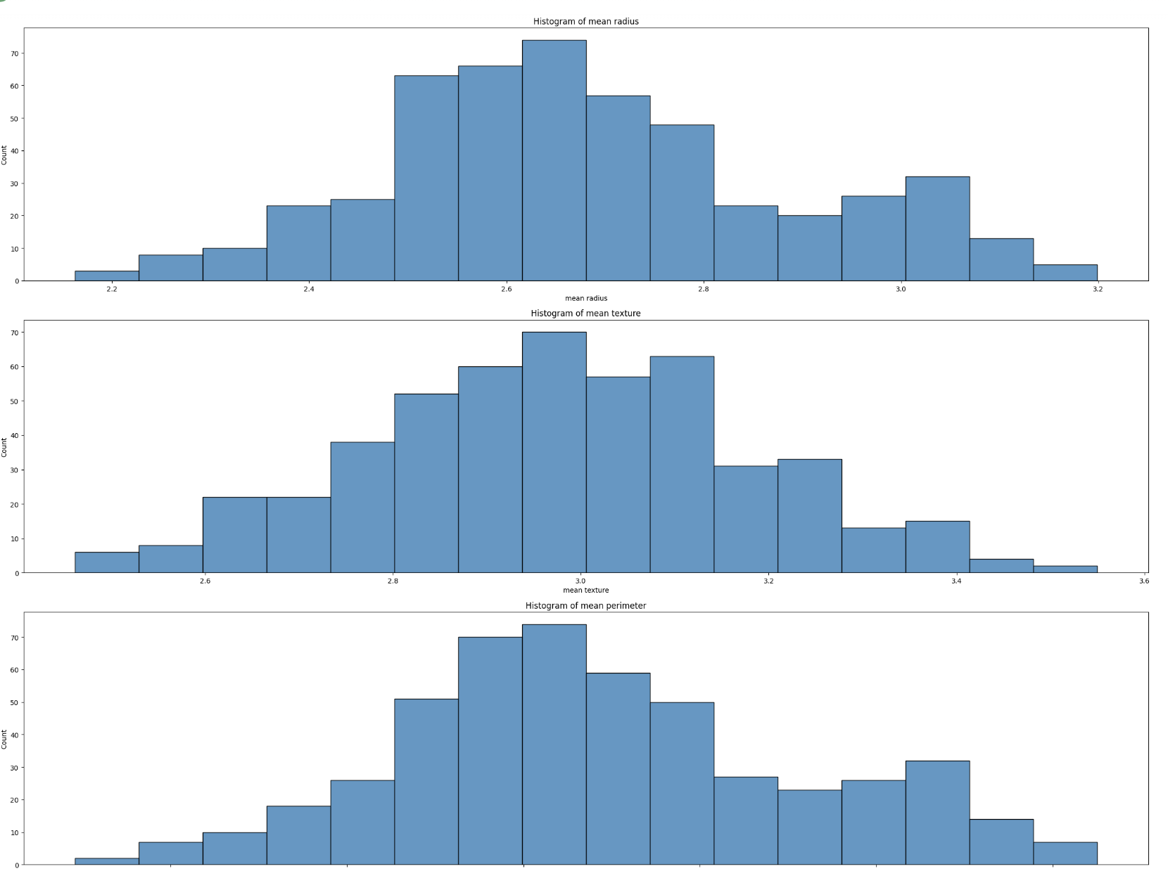
Skew Analysis
Histograms after cleaning
Here are the histograms from the mean radius, mean texture, and mean area columns from the cleaned data.
In comparison with the previous slide, we can see that the overall skewness has been reduced, and this trend is similar for the other columns plotted as well.

Slide 15
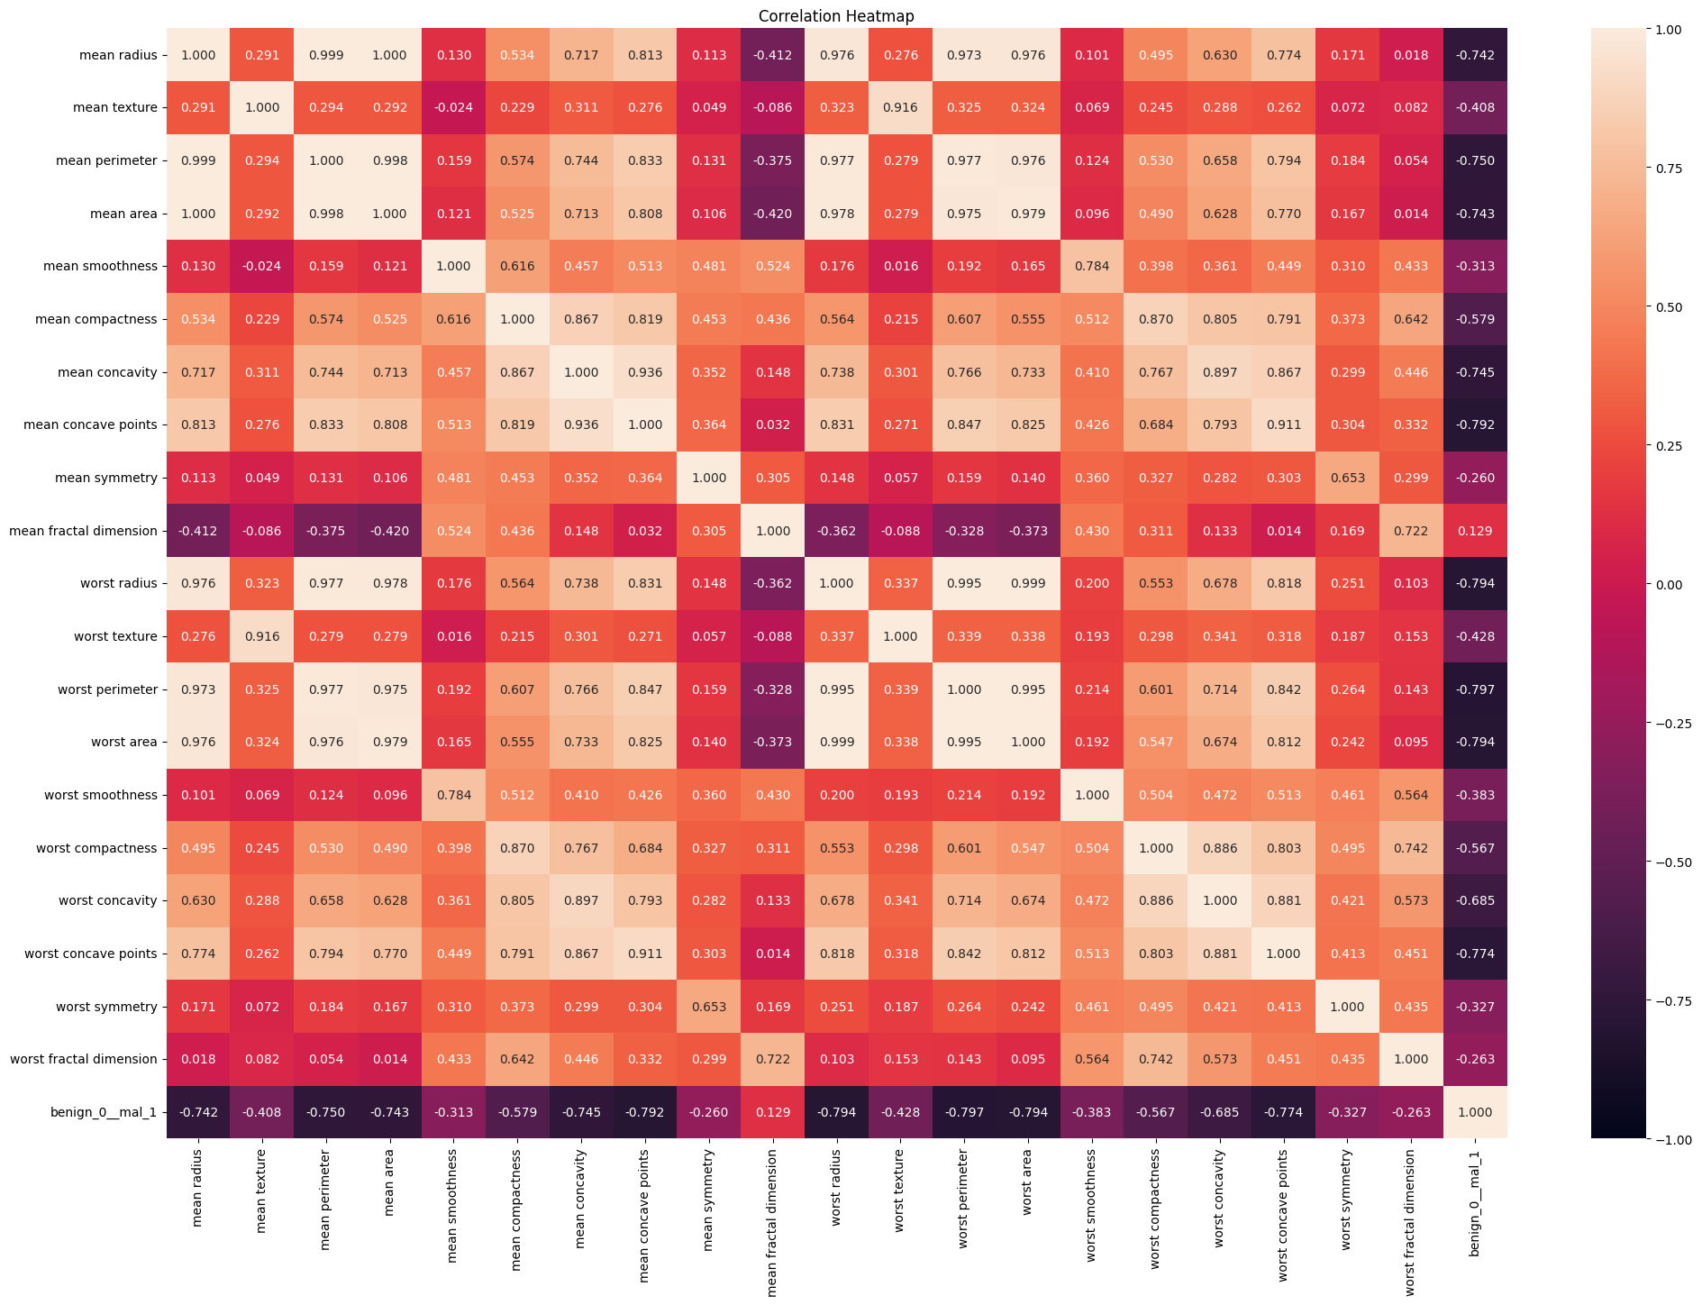
Selecting features to focus on
Heat map to get the correlation values between all columns.
We are trying to predict benign_0__mal_1, the binary value that indicates if the current sample is benign or malignant.
Narrowed down the columns we will work with by only choosing columns with a strong correlation with benign_0__mal_1.
9 columns to focus on: 'mean radius', 'mean perimeter', 'mean area', 'mean concavity', 'mean concave points', 'worst radius', 'worst perimeter', 'worst area', 'worst concave points'.

Slide 16
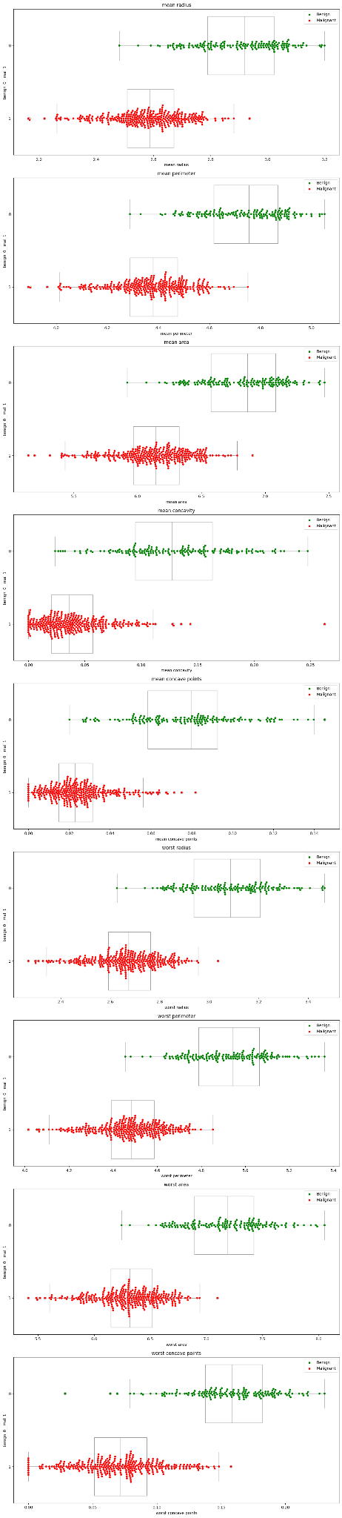
Suitability of features picked
Swarm plots to check on the overlap between Benign and Malignant box plots.

Slide 17
Suitability of features picked
Swarm plots to check on the overlap between Benign and Malignant box plots.
Better features for model prediction should have a low degree of overlap between the Benign and Malignant box plots
We can see that our selected features do indeed all have low levels of overlap through these swarm plots.

Slide 18
Machine Learning Techniques
03

Slide 19
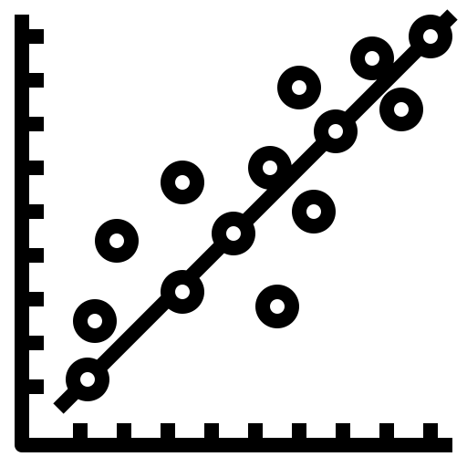

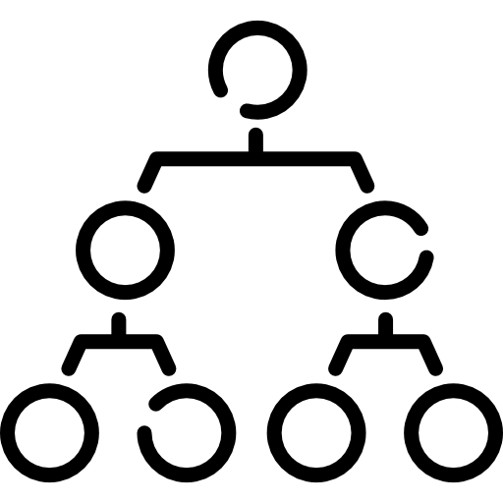
Models Chosen
Logistic Regression
Multivariate Classification Tree
Random Forest
Rationale and Requirements
Dataset Types
Our dataset comprised predominantly continuous variables, and our goal was to predict a categorical variable.
Performance
The model prioritise accuracy as it has the potential for future implementation in medical settings, where misdiagnosis carries significant consequences.

Slide 20
Models Chosen
Simplicity
Logistic Regression models are easily implementable and highly interpretable, which is important in a healthcare setting.
Logistic Regression
a statistical method used for binary classification, where the goal is to predict the probability of an input instance belonging to one of two classes.
Versatility
Able to be used for a wide range of binary classification tasks.

Slide 21
Models Chosen
Height of Tree
We decided to explore both a model with Tree Height 2 and a model with Tree Height 4, to determine which one leads to a higher classification accuracy.
Multivariate Classification Tree
A graphical representation of decision-making processes or decision rules that can be used to predict outcomes based on input features of variables.
Automatic Feature Selection
Decision Trees can automatically select important variables from the input data.
Ease of use
Decision Trees are easy to implement, and do not require complex calculations or intensive computational resources.

Slide 22
Models Chosen
Improved Accuracy
Increased accuracy as compared to a single decision tree.
Random Forest
An ensemble learning technique which combines multiple decision trees to create a more accurate and robust model.
Resilience to Overfitting
Random Feature selection of 400-1200 decision trees make Random Forest less prone to overfitting.
Notes:
https://towardsdatascience.com/feature-selection-using-random-forest-26d7b747597f#:~:text=How%20does%20Random%20forest%20select,random%20extraction%20of%20the%20features.

Slide 23
Model Comparison
04

Slide 24

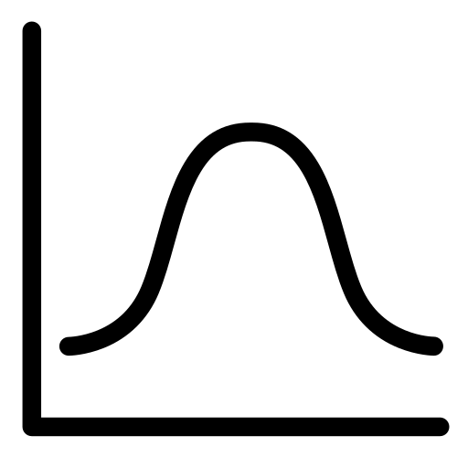


Analysis of Models
Area under Receiver Operating Characteristic Curve (AUC ROC)
Classification Accuracy
False Negative Rates (FNR)
F1-Score

Slide 25
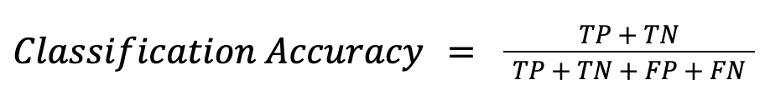
Classification Accuracy
Classification Accuracy is the the simplest measure of how well the model is performing. The higher the accuracy, the better.
Decision Tree (Depth = 2) | Decision Tree (Depth = 4) | Random Forest Classifier | Logistics Regression
0.9913 | 0.9032 | 0.9435 | 0.8790
Limitations of this metric:
A model might achieve high accuracy by simply classifying most cases as benign, even failing to identify many malignant cases.
Misclassifying a malignant tumor as benign (false negative) delays diagnosis and treatment

Slide 26

Area under Receiver Operating Characteristic Curve (AUC ROC)
AUC ROC measures the area under the ROC curve.
The higher the AUC ROC, the better.
Decision Tree (Depth = 2) | Decision Tree (Depth = 4) | Random Forest Classifier | Logistics Regression
0.8982 | 0.922 | 0.9915 | 0.9808
Limitations of this metric:
Breast cancer datasets are often imbalanced, with more benign cases than malignant ones. Changes in the decision threshold used to determine malignancy risk have significant consequences for patients.
A slightly lowered threshold might increase true positives (detecting more cancers) but significantly increase false positives

Slide 27

F1-Score
The F1 score or F-measure measures the reliability of the prediction of whether a patient is classified as healthy.
The larger F1-Score, the better.
Decision Tree (Depth = 2) | Decision Tree (Depth = 4) | Random Forest Classifier | Logistics Regression
0.9299 | 0.9193 | 0.9542 | 0.9068
Limitations of this metric:
The F1-score implicitly assumes equal importance for precision and recall.
However, in breast cancer detection, recall (correctly identifying malignant tumors) is arguably more crucial than precision (avoiding false positives).

Slide 28

False Negative Rates
False Negative Rates represent the cases where our model wrongly labels a patient with cancer as healthy.
The lower the FNR, the better.
Decision Tree (Depth = 2) | Decision Tree (Depth = 4) | Random Forest Classifier | Logistics Regression
0.0135 | 0 | 0.0135 | 0.0135
Limitations of this metric:
The False Negative Rate (FNR) tells us the percentage of malignant cases incorrectly classified as benign. However, it doesn't reveal how well the model identifies true cancer cases.
A model with a low FNR might look good, but if it also misses many malignant tumors (low sensitivity), it's dangerous for breast cancer detection. A false sense of security has severe consequences.

Slide 29
Consolidated Results
Metric | Decision Tree (Depth = 2) | Decision Tree (Depth = 4) | Random Forest Classifier | Logistics Regression
Accuracy | 0.9113 | 0.9032 | 0.9435 | 0.8790
AUC ROC | 0.8982 | 0.9220 | 0.9915 | 0.9808
F1-Score | 0.9299 | 0.9193 | 0.9542 | 0.9068
FNR | 0.0135 | 0.0000 | 0.0135 | 0.0135
Random Forest Classifier is the best model

Slide 30


Future Recommendations
Dataset Selection
Hyperparameter Tuning
Future models can be trained on larger and more extensive datasets
Using informed search strategies to automatically tune hyperparameters to find the best hyperparameters to reduce training time

Slide 31
Final Remarks

Slide 32
THANK YOU

